Slide 1

Ad-Hoc OLAP Query Processing Engine
CS562 Project Presentation
Team: Rangasai Kumbhashi Raghavendra
https://ieeexplore.ieee.org/document/787619

Slide 2
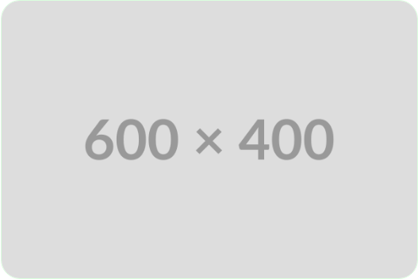
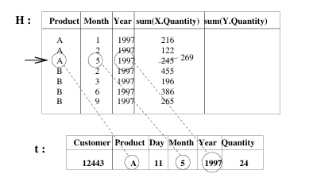
Project Summary
•
Problem: Standard SQL is inefficient for complex Ad-Hoc OLAP queries (e.g., self-joins).
•
Solution: Implementation of the Phi Operator and EMF syntax.
•
Significance: Replaces complex joins with a Scan-based algorithm for In-Place computation.

Slide 3
Demo Agenda
•
Architecture
•
Overview
•
Query Walkthrough
•
Complex Scenarios

Slide 4




High-Level Architecture
1. Input
2. Parser
3. Generator
4. Execution
Text file with Phi parameters.
Converts text to PhiOperator object.
Runs logic against PostgreSQL.
Compiles object into Python script.

Slide 5
Query Structure (Phi Operator)
•
S (Selection): Attributes to output.
•
n (Grouping Variables): Number of scans.
•
V (Grouping Attributes): Columns defining a group.
•
F-VECT: Aggregate calculations.
•
PRED-LIST: Logic for each variable.
•
HAVING: Final result filter.

Slide 6





Technology Stack
Language
Database
Python 3: Chosen for strong string manipulation capabilities needed for code generation.
PostgreSQL: Stores the sales fact table.
Libraries
psycopg2 for DB connectivity, python-dotenv for credentials, os/sys for execution.

Slide 7
Functional Components
f(get_aggregate_type)
Initialize values for MF-struct types
f(generate_mf_struct)
Generate MF-struct definition
f(generate_predicate_code)
Generate row filters during the scan
f(generate_aggregate_scans)
Generate MF-struct definition
f(generate_having clause)
Generate filters on the final H-Table rows

Slide 8
Limitations
•
Full Outer Join: Reduce data to subset of valid domains.
•
Naive Type Handling: Assumes data types.
•
Strict Input Formatting: Parser limitations.

Slide 9
Optimizations
•
Memory Constraints: In-Memory MF-Structure (Future: Disk-based swapping).
•
Algorithmic Complexity: Nested Loop O(N*G) (Future: Hash Maps for O(1)).
•
Distributed Computing: Split grouping variable computations across nodes.
•
Reduction in Scans: Independent grouping variables’ results can be calculated in one scan..

